Slide 1

Player Performance Analysis in a Tournament
- Venkata Srikar Potharaju

Slide 2
About me
My Name is Venkata Srikar Potharaju
B. Tech, EEE graduate from Vellore Institute of Technology Vellore.
I worked as an Associate Software Developer and want to change to Data Domain to analyze and draw insights from Data that help in decision making.
LinkedIn : https://www.linkedin.com/in/venkata-srikar-potharaju-1746b2218
GitHub: https://github.com/vksrikarp

Slide 3
Agenda
Business Problem
Tools Used
Problem Statement
Objective
ER Diagram and Schema Explanation
SQL Queries Results
Business Key Insights
Conclusion
Recommendations
Q & A

Slide 4
Tools Used
Synthetic Data Generation and Data Transformation: Advanced Excel using ChatGPT.
Database Management: SQL
Queries: MySQL, Jupyter Notebook (MySQL Connector)
Dashboarding: MS Excel, Power BI

Slide 5
Business Problem
A Tournament involves hundreds of players participating across multiple matches and innings. Coaches, selectors, analysts, and team management require an objective, data-driven approach to evaluate player performance instead of relying solely on total runs or Wickets. Traditional scorecards provide match-wise statistics but do not answer strategic questions such as :
Who are the most consistent performers and Which young players have the highest growth potential ? Which bowlers perform well in pressure situations and Which batters contribute most to winning matches ? Which players are underperforming despite getting opportunities ?
A centralized analytics dashboard is required to transform raw scorecard data into actionable insights for player selection and performance evaluation.
Note: The data taken is synthetic data.

Slide 6
Problem Statement
Develop an end-to-end analytics solution using SQL and Power BI to analyze batting and bowling performances across the Tournament 2025–26 season. The solution should identify :
Top-performing batters and bowlers, Consistent performers, Emerging future stars Match-winning contributors, Team-wise strengths and weaknesses, The system should enable selectors and analysts to make data-driven decisions rather than subjective judgments.

Slide 7
Objective of Project
Build a structured cricket analytics database.
Analyze batting and bowling performances across all matches.
Identify the best batter and best bowler.
Detect consistent performers.
Identify future star players.
Compare team performances.
Create interactive Power BI dashboards.
Enable player comparison.
Discover hidden performance patterns.
Provide insights for team selection.

Slide 8
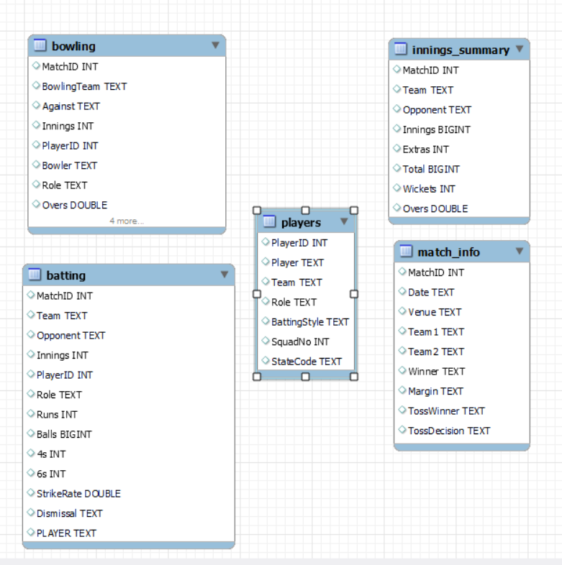
ER Diagram and Schema Explanation
Parent Table | Child Table | Cardinality
Country | Emissions | 1 : Many (1:N)
Country | Production | 1 : Many (1:N)
Country | Consumption | 1 : Many (1:N)
Country | Population | 1 : Many (1:N)
Country | GDP | 1 : Many (1:N)
Notes:
Why is country-to-emissions a one-to-many relationship?
Because a single country can have multiple emission records across different years and energy types, while each emission record belongs to only one country. Therefore, one country is related to many emission rows, making the relationship one-to-many.
The same explanation applies to:
Country -> GDP
Country -> Population
Country -> Production
Country -> Consumption
All of them store historical data (multiple years), so one country maps to many rows.

Slide 9
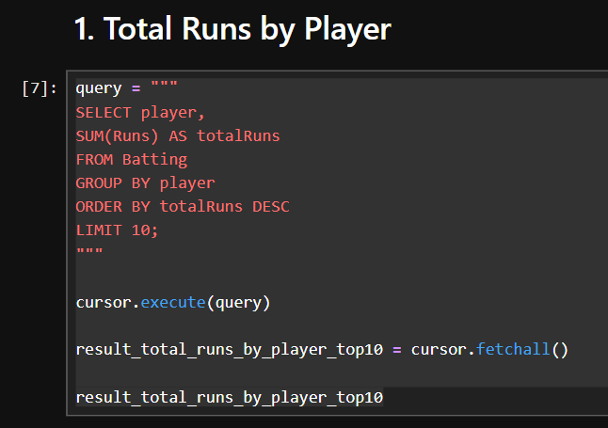
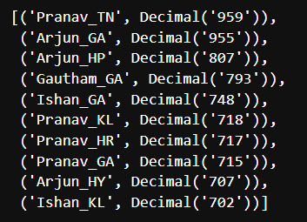
SQL Queries Results
01. Top 10 Total Runs by player
Pranav from Tamil Nadu is the top scorer of the tournament with 959 runs followed by Arjun from Goa team.

Slide 10
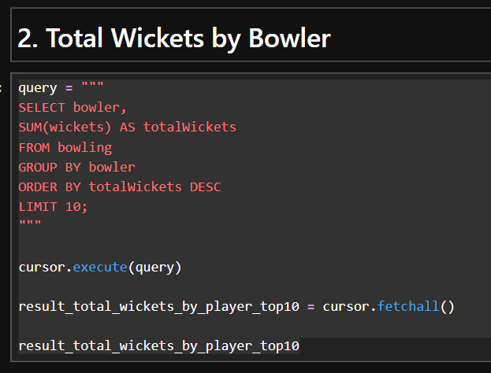
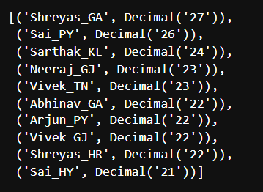
02. Top 10 Wicket Takers
Shreyas from Goa team is leading wicket taker of the tournament with 27 wickets.
Sai from Pondicherry is second highest wicket taker with 26 wickets.
Bowler’s contribution with wickets is also important factor for the team to win.

Slide 11
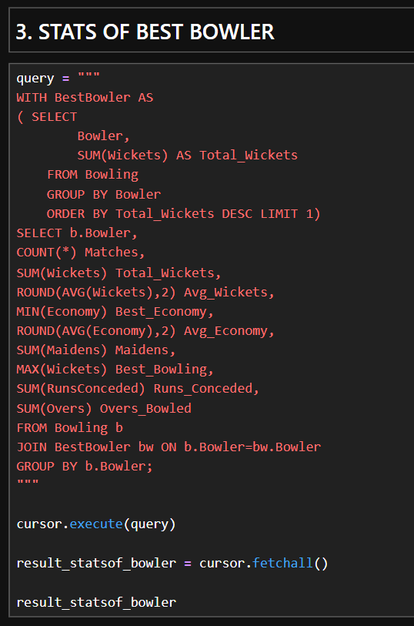
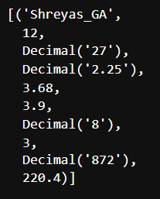
03. Statistics of Best Bowler of Tournament.
Shreyas from Goa performed exceptionally well in the tournament with 27 wickets 3.68 economy.

Slide 12
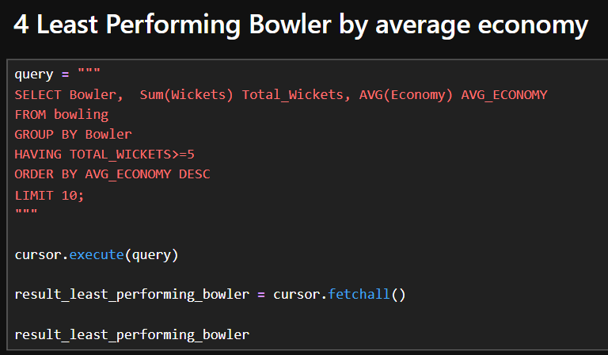
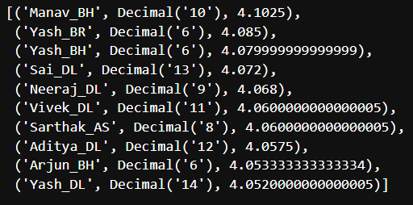
04. Least Performing Bowler by average Economy.
Manav from Bihar had hard luck with bowl in the tournament with economy of 4.10.
Manav has taken 10 wickets.
The player needs to work on his strength and weakness.

Slide 13
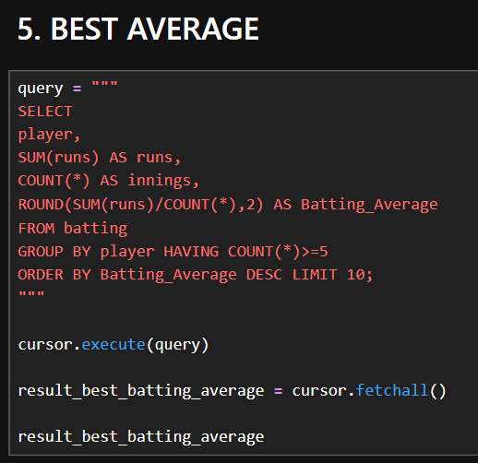
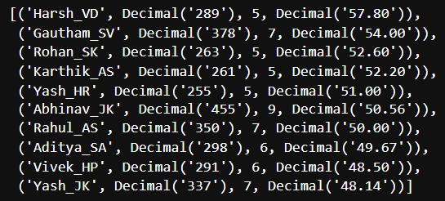
05. Batter with Best Average
Harsh from Vidarbha team has highest batting average of 57.8 runs in 5 innings with a total of 289 runs.
Interestingly highest run scorer of tournament does not have highest average in this tournament.

Slide 14
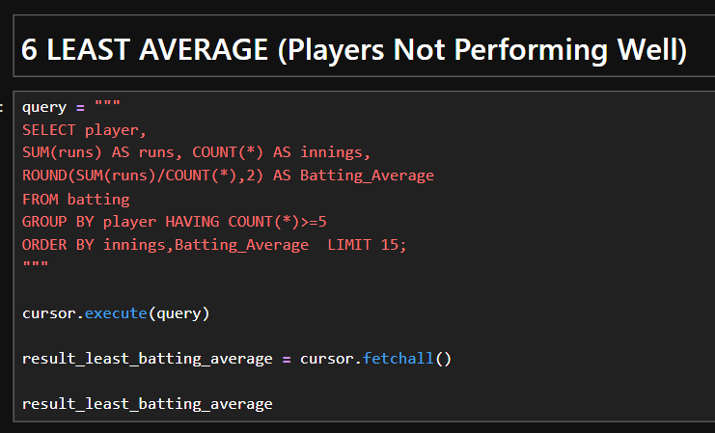
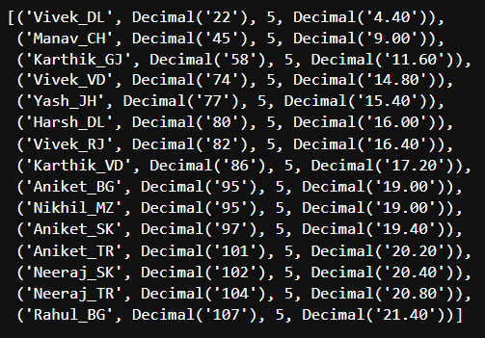
06. Batters with Least Average
Vivek from Delhi scored 22 runs in 5 innings with average of 4.40.
These batters should work hard on their skills.

Slide 15
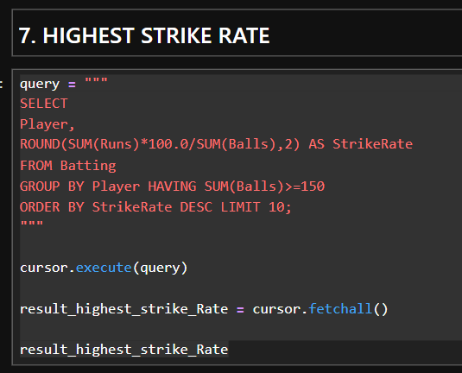
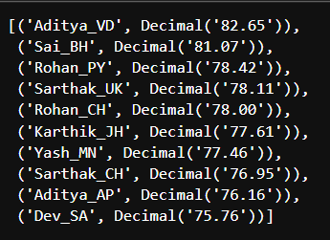
07. Batters with Highest Strike Rate
Adithya from Vidarbha has highest strike rate of 82.65 runs in the tournament,
followed by Sai from Bihar with 81 runs.

Slide 16
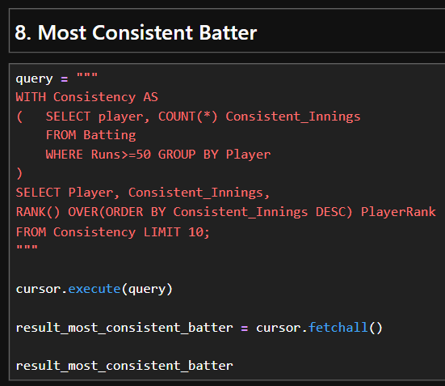
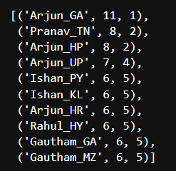
08. Most Consistent Batter
Arjun from Goa is most consistent player in the tournament.

Slide 17
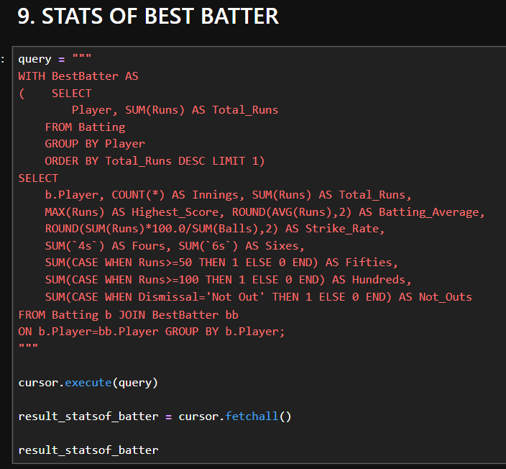
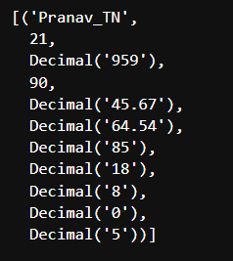
09. Statistics of Best Batter
Pranav from Tamil Nadu has scored highest in the tournament with 959 runs.
90 runs is his batting average. 45 runs strike rate.

Slide 18
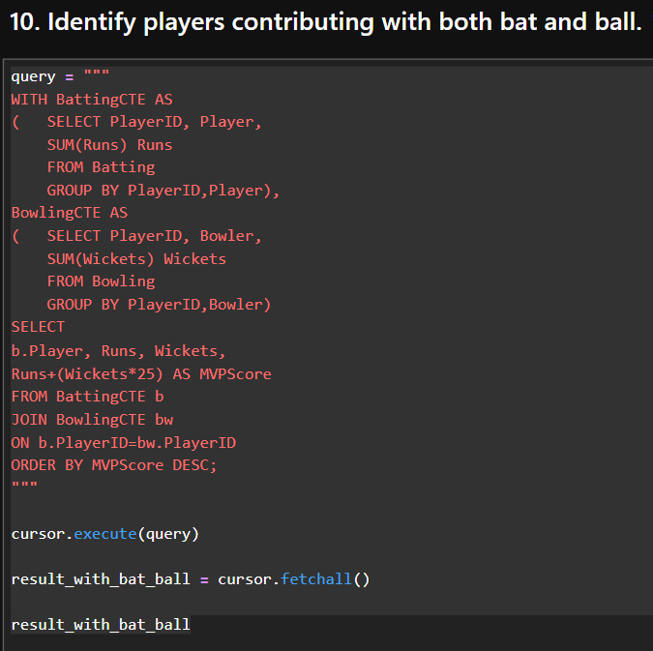
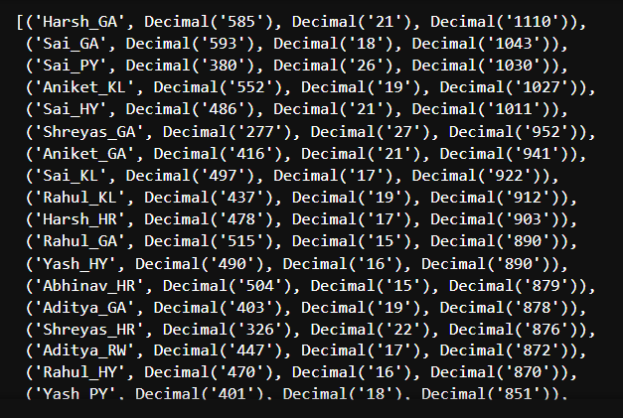
10. Batters with Highest Strike Rate
Harsh and Sai from Goa contributed with both bat and ball with 585 runs 21 wickets and 593 runs 18 wickets respectively.
All rounders bring balance in the team with both bat and ball.

Slide 19
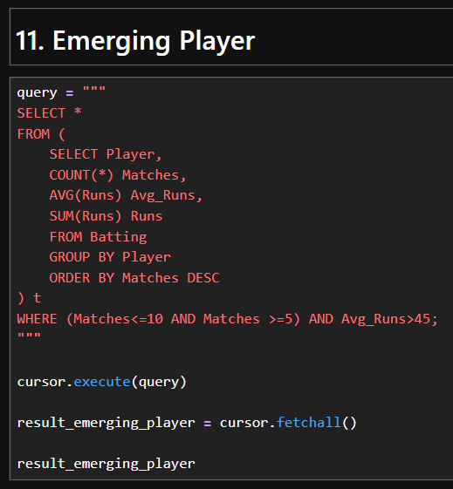
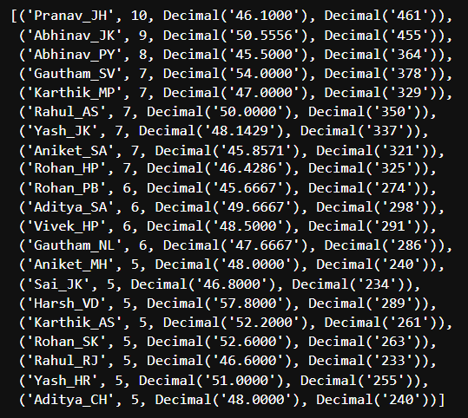
11. Batters with Highest Strike Rate
Pranav from Jharkhand with average of 46.10 runs is one of the emerging players.
The list also include Abhinav from Jharkhand, another Abhinav from Puducherry.

Slide 20
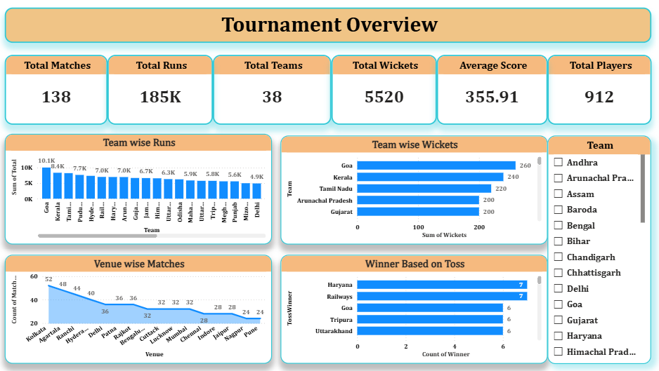

Slide 21
Insights
There are 138 matches conducted in the tournament amongst 38 teams.
Pranav from Tamil Nadu is the top scorer of the tournament with 959 runs followed by Arjun from Goa team.
Pranav from Jharkhand with average of 46.10 runs is one of the emerging players.
The list also include Abhinav from Jharkhand, another Abhinav from Puducherry.
Harsh and Sai from Goa contributed with both bat and ball with 585 runs 2 wickets and 593 runs 18 wickets respectively.
All rounders bring balance in the team with both bat and ball.
Arjun from Goa is most consistent player in the tournament.

Slide 22
Recommendations
The Bowlers with more economy and less wickets taken should work on their bowling strengths.
The Batters who have less strike rate and low scores needs to improve in the areas where they lose wicket easily.
Players who contribute with bat and ball are key players.

Slide 23


Slide 24

THANK YOU

